Slide 1
OUR MISSION:
The Pittsford Crew Community will achieve a winning tradition in a safe and fun environment. We will teach rowing while instilling the values of fairness, respect, and teamwork. Our Community is dedicated to providing an enriching experience that strives for athletic excellence, supports youth rowing and inspires a life long passion for the sport.

Slide 2
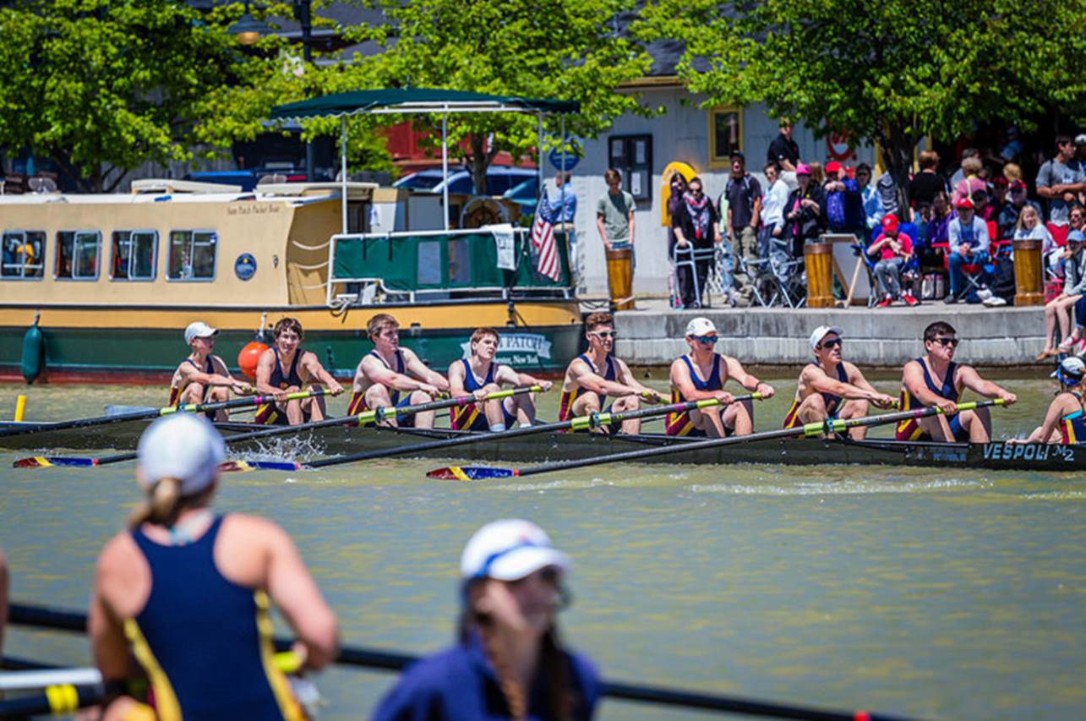
Pittsford Crew
Parent Information
March 16th, 2016

Slide 3
Introduction of Pittsford Crew Board Members
Introduction of Coaching Staff
Pittsford Apparel
Catch This / Regatta Information Updates
Remaining Agenda
  Health & Safety
  Fund Raising
  Expectation & Preparation

Slide 4
Dr. Jeff Allen
Chair of Health & Safety

Slide 5
Guidelines for NOT participating in practice or competition
Symptom | Action Required
Infectious Mononucleosis - | no participation for 4 weeks from clinical presentation*
Fever – | no participation until no fever for 24 hours
Gastroenteritis (nausea/vomiting/diarrhea) | no participation for 48 hours after resolution
Cellulitis (Skin Infections) – | no participation until taking antibiotics for 72 hours
Influenza – | no participation for 14 days from clinical presentation
Respiratory Infections – above neck/no fever below neck | no restriction case by case, but requires clearance by MD
*clinical presentation = date of onset of initial symptoms
SELECTED REFERENCES:
http://www.britishrowing.org/news/2011/september/13/avoiding-and-managing-seasonal-illness
Metz, J.P. Upper respiratory tract infections: who plays, who sits?. Curr Sports Med Rep. 2003;2:84–90
Waninger K and Holschen J. Infectious Disease in Sports Medicine. ACEP Lecture Series. 2009

Slide 6
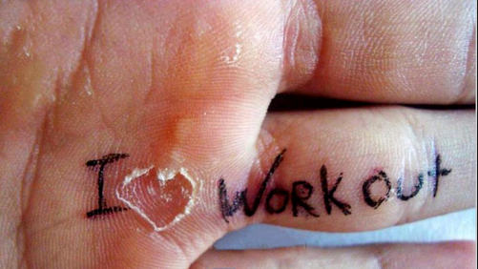
Health and Safety
Hand Hygiene
  Soap and water (or hand sanitizer) after every practice
  Intact skin - “ don’t pop blisters”
  Topical Antibiotic / sterile dressing x 24 hours
  Protect at practice until callous
Coordinated Oar cleaning campaign
See addition information in Parent Packet
  Keep coaches informed of illness
  Launches equipped with First Aid Kits

Slide 7
Elena Litterio
Fundraising Coordinator

Slide 8
Spring Fundraising:
“Crew for the Kids” Erg-a-thon
Sunday April 10, 2016 at the Lego Court / Eastview Mall
History- National Program brought local
Purpose- New equipment purchases, building and facilities upkeep, raise money to benefit Golisano Children’s Hospital
Location purpose/goals- To raise community awareness of our club, make an impact on the community at large, reinforce the importance of community service, involve our families and the community in our efforts.
How- Piggybacker, mailers, walk abouts, friends at the event
Sign up starting NOW through ivolunteer for erging time slot

Slide 9
Spring Fundraising:
“Crew for the Kids” Erg-a-thon
Piggybackr crowd funding- Create a personal fundraising page( your email will be sent an invitation and link ) by 3/22
Send 20 emails or mailers by 3/27 ( if each person gives $10.00 you make your $200.00 goal!)
Create a FB/ media event by 4/4 ( goal is 10 Friends to cheer you on and donate $1.00 each) $10. x 140 athletes =$1400.00
Come to the erg-a thon hydrated, dressed in Uni or gray wear with black shorts
Sign up for erg times ( two, 30 minute sessions) on iVolunteer (P Crew website)
Piggybackr closes 5/15-Thank your donors / receive your deposit check at the end of the year picnic
Notes:
9

Slide 10
Barb Kindig – Novice Head Coach
Ethan Curren – Varsity Girls Head Coach, Rowing Director
Jon Covney – Varsity Boys Head Coach, Program Coordinator

Slide 11
Varsity Rowing Classification
Open weight (unlimited weight)
Competing as a Lightweight (Boys: 150 lbs, Girls: 130 lbs):
  Younger rowers may be natural lightweights
  Few older rowers are natural lightweights
  Loss of muscle mass is a common result of weight loss
Athletes who wish to compete as lightweights should meet the following criteria:
  Erg scores should remain stable or improve as they remain below the weight limit.
  For those athletes who are near the weight limit, they should not try to lose more than 1 lb per week.
For spring season 2016:
Any athlete wishing to compete as a lightweight will be weighed at the start of the season.
  Refer to registration website for lightweight policy/procedures
  Athletes should discuss with coaches at the start of season (Varsity Only)

Slide 12
Winter & Spring Practice Schedule
All current practices held in PIRC and at Pilates Plus 2/22 until 3/25
Refer to practice schedule located on the website - the rest of the season is on the website
Practice times change once we return from spring break
Practice times will change again once we are on the water – depends on the water level on the canal
Athletes should arrive 10-15 minutes before daily practice time.

Slide 13
Be prepared for practice
Hearty breakfast, including protein
Substantial lunch
Pre-practice snack…especially if early lunch!
  Protein, Carbs, & Fiber
Sports drink for practice
Recovery snack for after practice
  Should be consumed on site

Slide 14
What to bring to practice
Appropriate clothes
  They should check the weather forecast, not just current conditions
  Avoid cotton in cold or cool wet weather
  No loose baggy clothing
  Hi-visibility clothing recommended
Athletes should have a hat:
  with visor for sunny days
  Warm for easy temperature regulation for cool days
Sun glasses:
  Polarized
  Croakies
  Especially cox’ns and those in straight boats
Tape for blistered hands
Cox’ns Tools
  7/16ths
  Small Adjustable
  Interchangeable headed screwdriver
  Electrical tape
  Recording device (optional)

Slide 15
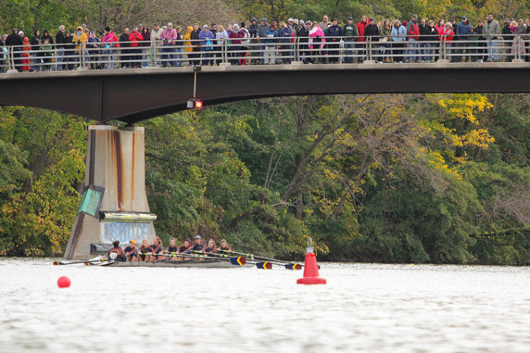
Spring Regatta Schedule
Ithaca Icebreaker:
  Novice and Varsity, Sunday, April 24th
States - Saratoga:
Novice: May 13th and May 14th
Varsity: May 13th, 14th, 15th
Contact Mary Jo by 3/16 regarding
Jazz Concert/Prom conflicts
Syracuse Chargers Regatta:
Novice and Varsity, Saturday, May 21st
Pittsford Village Regatta – Paddle and Pour
Novice and Varsity, May 28th & May 29th

Slide 16
What to bring and do during race day
Team spirit and high expectations
Change of clothes
Rain gear and extra warm layers - avoid cotton
Things to do between races
  Assist teammates & coaches with equipment needs
    Helps if rowers have 7/16th wrenches
  Homework

Slide 17
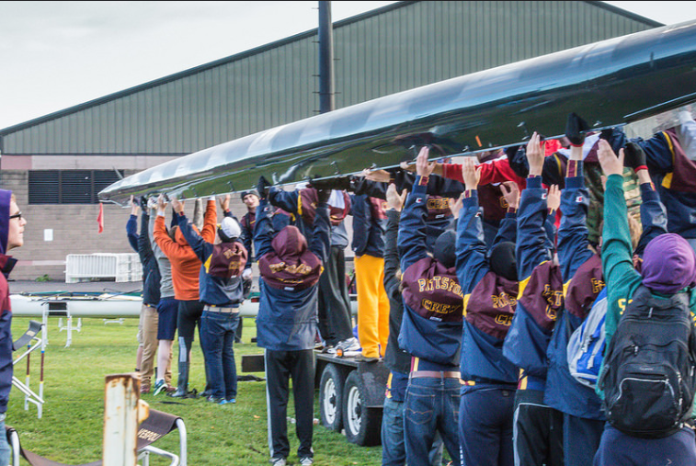
Regatta Transportation
All rowers are expected to be at the regatta all day to help unload/reload trailers
  For local regattas, parents provide their athletes’ transportation
    Driving directions will be on the website
    Rowers may NOT drive themselves to regattas beyond Monroe County limits
  NOTE: Varsity Rowers Regarding Nationals
  If Varsity has boats qualify for Nationals at States, a separate parent meeting will take place
  Monday, May 16th after the boys practice is over

Slide 18
What can you do to help your Athlete?
Come to races!
Help them negotiate the peaks and valleys
Help them and us with issues of injury and illness
Support their Fundraising efforts
Things to try to avoid:
  Prying
  Putting pressure on them to perform, or criticize
  Avoid schedule conflicts
  Trying to leave early from team events when boats need to be rigged and loaded
Notes:
Come to races!
Give them (and the team) space pre-race.
They want you to see their triumphs.
They may want consolation if they stumble.
Even if they don’t admit it, they appreciate it.
Wear team gear! It helps you to find other parents (and new ones to find you), and it supports the team!
Help them negotiate the peaks and valleys.
One day they might be ecstatic, the next day their lives are over!!! Providing perspective is important.
Help them and us with issues of injury and illness.
Symptoms below the neck= don’t come to practice.
Especially the motivated athletes will tend to hide injuries and illness. Have they really told the coaches? Never hesitate to reach out.
If they have to miss practice for a protracted period this can have psychological impact as well: they are missing structure and their teammates. We need to work together to mitigate this.
Don’t:
Pry. Instead just ask how you can support them, and let them know you are there for them.
put pressure on them to perform, or criticize. Instead tell them you are proud when you see them working hard or making good decisions.
Schedule conflicts. Instead try when possible to show your support for their athletic career by accommodating when scheduling things like doctor dentist, tutoring and other appointments. Ask our advice if you need to.
Expect to leave early from team events when boats need to be rigged and loaded. Instead if an athlete has a potential conflict after a regatta, work with coaches ahead of time. Also remember rowing happens at the mercy of the elements and delays are common.

Slide 19
Coaches Group Discussions

Slide 20
Appendix

Slide 21

Policies & Procedures
READ the HANDBOOK!!
Web site: go to “More”,

Slide 22
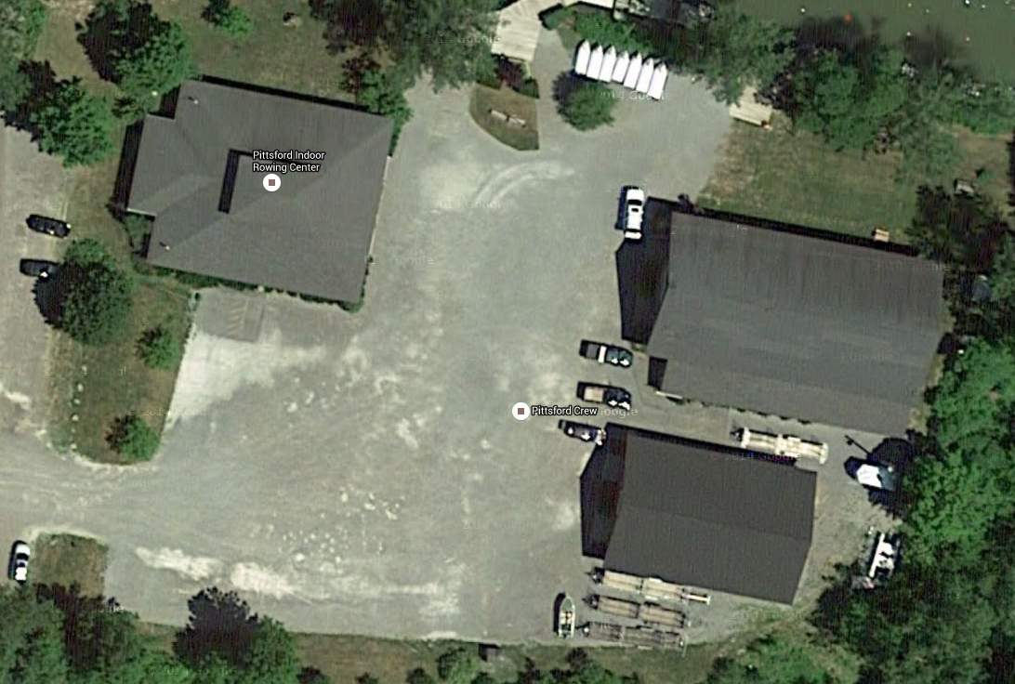
Parking & Driveway Etiquette
Be aware of the traffic patterns shown below. In particular, you should not travel into the area between the large boathouse and the PIRC (Pittsford Indoor Rowing Center). This area is usually blocked by cones, and is needed by kids to maneuver boats into the boathouse. Drive slowly, we have some small athletes not easily seen as they attempt to find their cars.
Secondly, there are NO left turns out of the driveway – be good role models and reminder your young drivers. The exit does not allow a good view of oncoming traffic.
No Parking
Parking
Parking
Parking

Slide 23
Where does my Tuition Go?
Coaches’ Salaries
Coach Training
Hospitality at Regattas
Pittsford Indoor Rowing Center
Regatta Fees
Equipment Maintenance
Insurance, more insurance
Boathouse Master
Utilities and Building Maintenance
Launches and Truck Gas
US Rowing Membership
And the list goes on…
  To bring your child an outstanding program!

Slide 24
Pittsford Equipment-
High level overview
Equipment Purchases from Fundraising 2010 – 2014
6, Vespoli 8+ shells
3, Vespoli 4+ shells
1 Quad
1 Double
3, Singles
12 Pair sculling oars
24 Sweep oars
New docks – 60’ and 180’
Truck for towing boat trailers and snowplowing
3 Safety launches
2 Launch motors
Hospitality trailer
Marine radios for on water safety
Exercise bike
Digital scale
Hospitality grill
Many pairs of boat shoes
Several cox boxes and more!
Keep our kids in quality equipment = Support our fundraising efforts!

Slide 25
Health and Safety
Health Forms from MD / Pittsford Crew Sports Questionnaire
  Identify Specific needs (Asthma Action Plans, Diabetes, Allergies…)
  Prevent /predict medical problems
  *Update during season if any changes*
U.S. Rowing Safety Guidelines
  Swim Test – required for participation
  Coaches Training –
    First Aid Training twice yearly/Red Cross BLS/ Sports specific training
    First aid equipment/AEDs on site
  Safety On The Water
    Launches are equipped with safety equipment
    Weather Conditions
    Water flow rate
    Air and water temperature

Slide 26
Fundraising
Corporate sponsorship program:
  Logo on website, regatta banners, and on regatta programs
  Gold level $500 (one year), Silver level $250 (one season)
  Information folders available tonight, also a tab on the website
  Contact Elena Litterio with any questions
Notes:
26

Slide 27
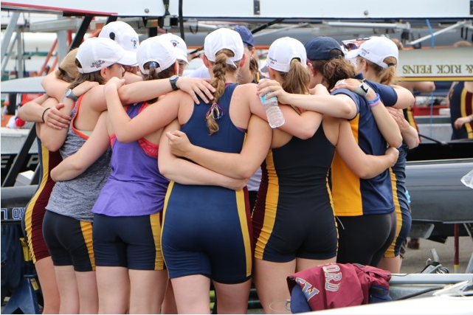
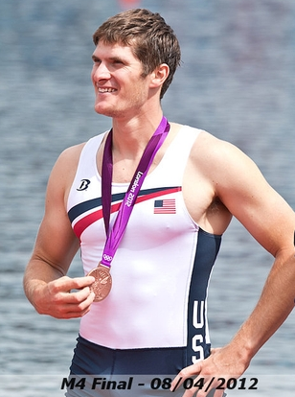
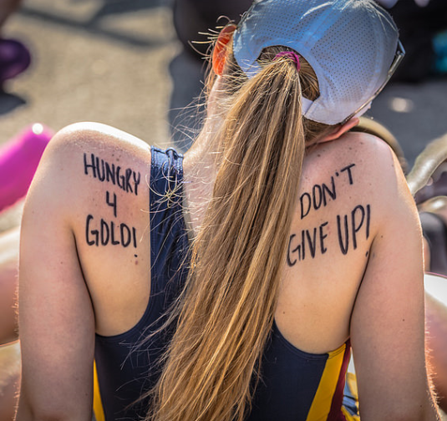
Benefits of Rowing
Great way to get/stay in shape
Learn valuable life skills
  Team work
  Communication
  Builds character
Make lifelong friends
Opportunities in College and beyond
Rowers are among the world’s best athletes. Rowing looks graceful, elegant and sometimes effortless when it is done well. Don’t be fooled. Rowers haven’t been called the world’s most physically fit athletes for nothing. The sport demands endurance, strength, balance, mental discipline, and an ability to continue on when your body is demanding that you stop. (usrowing.org)

Slide 28
Expectations
Attendance
  Minimize absences – they effect more than your athlete but the whole boat
  If an athlete has to miss, contact coach in writing (email is fine) preferably a week or more before AND the day before
  If its short notice please send email to the athletes coach and the head coach

Slide 29
What can you do to help your Athlete?
Come to races!
  Give them (and the team) space pre-race.
  They want you to see their triumphs.
  They may want consolation if they stumble.
  Even if they don’t admit it, they appreciate it.
  Wear team gear! It helps you to find other parents (and new ones to find you), and it supports the team!
Help them negotiate the peaks and valleys.
  One day they might be ecstatic, the next day their lives are over!!! Providing perspective is important.
Help them and us with issues of injury and illness.
  Symptoms below the neck= don’t come to practice.
  Especially the motivated athletes will tend to hide injuries and illness. Have they really told the coaches? Never hesitate to reach out.
  If they have to miss practice for a protracted period this can have psychological impact as well: they are missing structure and their teammates. We need to work together to mitigate this.
Things to try to avoid:
  Pry. Instead just ask how you can support them, and let them know you are there for them.
  put pressure on them to perform, or criticize. Instead tell them you are proud when you see them working hard or making good decisions.
  Schedule conflicts. Instead try when possible to show your support for their athletic career by accommodating when scheduling things like doctor dentist, tutoring and other appointments. Ask our advice if you need to.
  Expect to leave early from team events when boats need to be rigged and loaded. Instead if an athlete has a potential conflict after a regatta, work with coaches ahead of time. Also remember rowing happens at the mercy of the elements and delays are common.

Slide 30
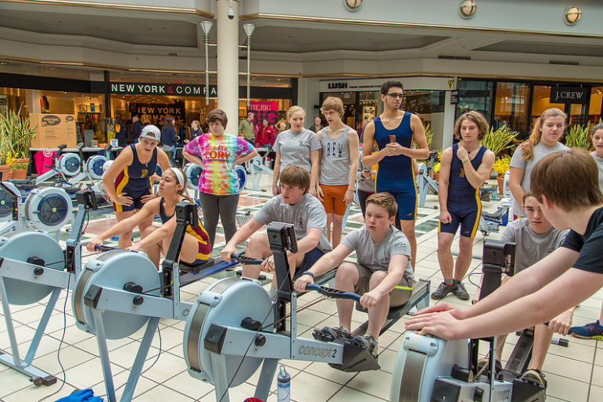
Things to consider--optional but helpful for the dedicated athlete
Heart rate monitor
  More important for more experienced athletes
    With Calorie counter
    Polar, Garmin, Suunto
    Blue tooth will interface with new ergs
Concept2 Erg
  Very sturdy
  Maintain value
  Allow for work to be done at home

